Slide 1
ZOMATO DATA ANALYSIS

Slide 2
GROUP 5
MEMBERS:
MS. BANDANA HAZARIKA
MR. ARIF ABDUL MULANI
MR. SAYAN MUKHERJEE
MR. RUPESH RAMESHWAR AGADE

Slide 3
INTRODUCTION
In this project we have used Zomato's extensive dataset, comprising restaurant information, customer reviews, and ratings, offers a unique opportunity to decipher the complex tapestry of the global culinary landscape. This analysis goes not only beyond numbers but also understanding the stories behind each dish, the nuances of every review, and the trends shaping our dining choices.

Slide 4
PROJECT AIM
People prefer which kind of foods and cuisines throughout different regions around the world.
Kind of restaurants which are preferred by people.
Which type of restaurant is profitable to open in which region.
Revenue generated by different restaurants.
Varying price range of different cuisines country wise.

Slide 5




Approach
Groups , bins, measures, filters
Power query
EDA
Data Pre processing
Data Analysis
Classification
Get data
Statistical analysis
cleaning
Transforming
Data validation
Data visualization
Dashboards
KPI’s
Power BI
Charts, cards, conditional formatting

Slide 6



Tools and visualizations used in analysis
Calculated
Fields
Parameters
Conditional formatting
Slicers
Visualization
Power BI
Measures
Dax
Parameters
Conditional formatting
Slicers
Actions
RDBMS
Fetching
Joins
Triggers
Def Functions
Functions
Filters
Pivot Table
Conditional formatting
Slicers

Slide 7
KPI’s
Month-Wise YOY Sales
Weekday/Weekend Table booking & Online delivery
Continent & Cuisine-Wise Sales & Votes
Financial Quarter & Month-Wise Sales
Rating-Wise Customer Satisfaction

Slide 8
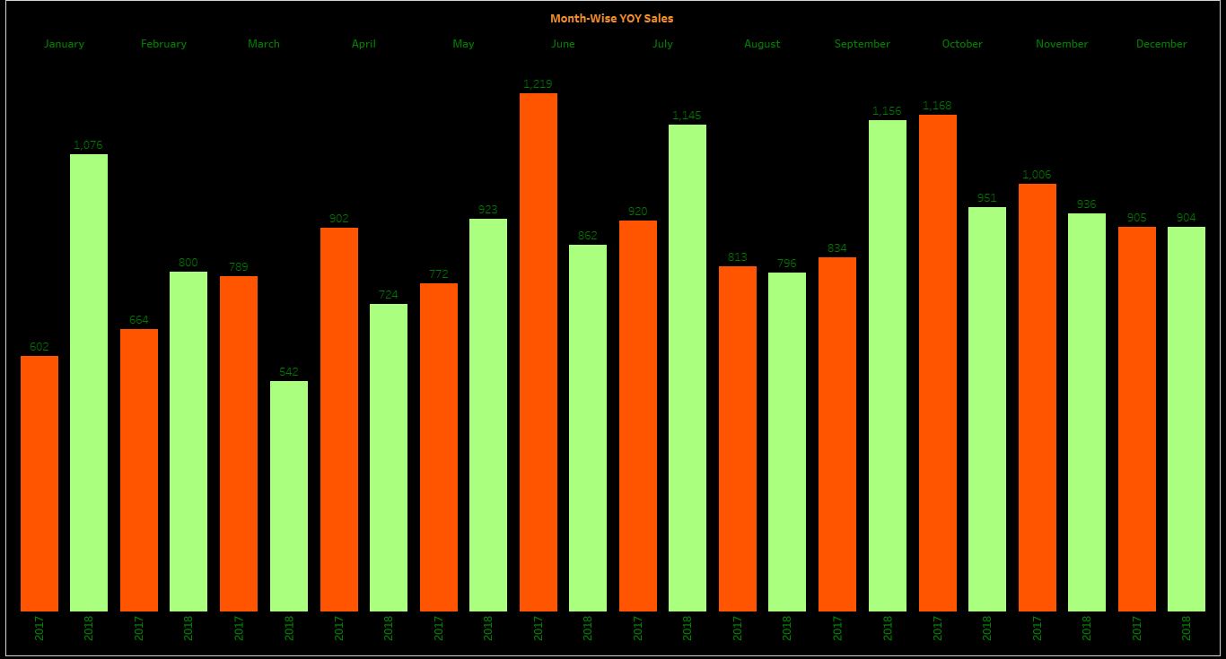
Month-Wise YOY Sales
For the last 2 years, the revenue of 2018 crossed 2017 by 2 % on YoY basis

Slide 9
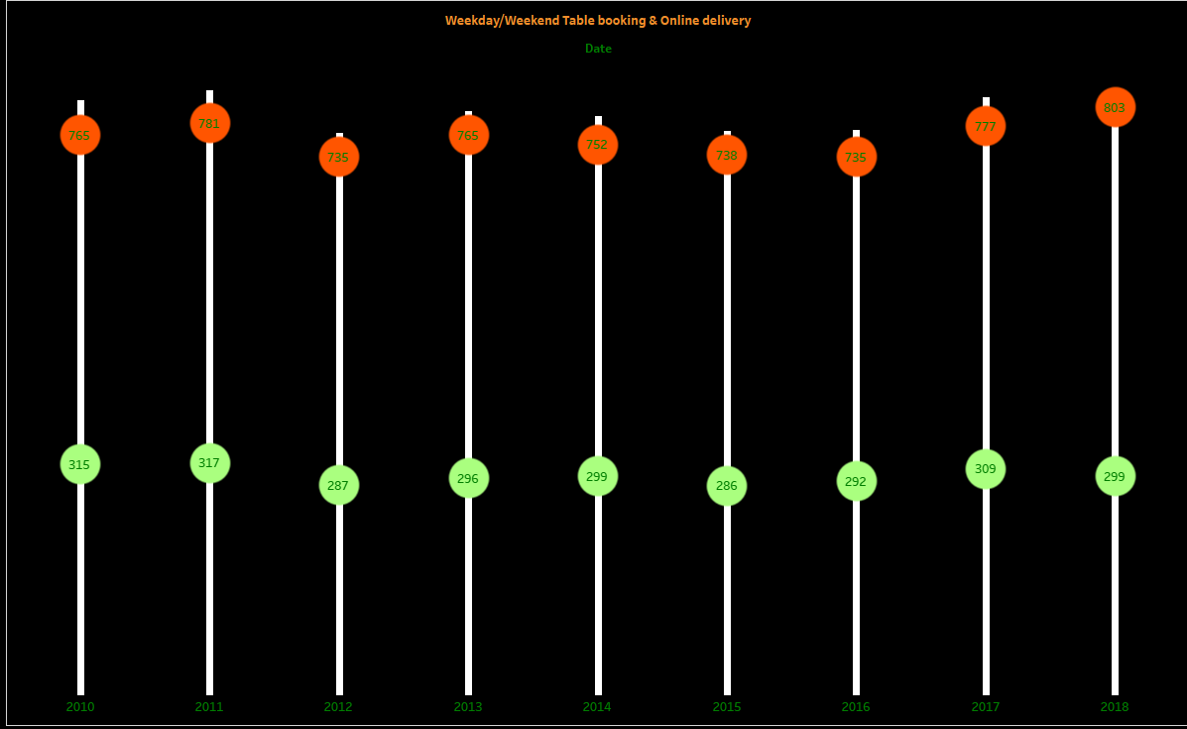
Weekday/Weekend Table booking & Online delivery
Customers prefer weekdays over weekends

Slide 10
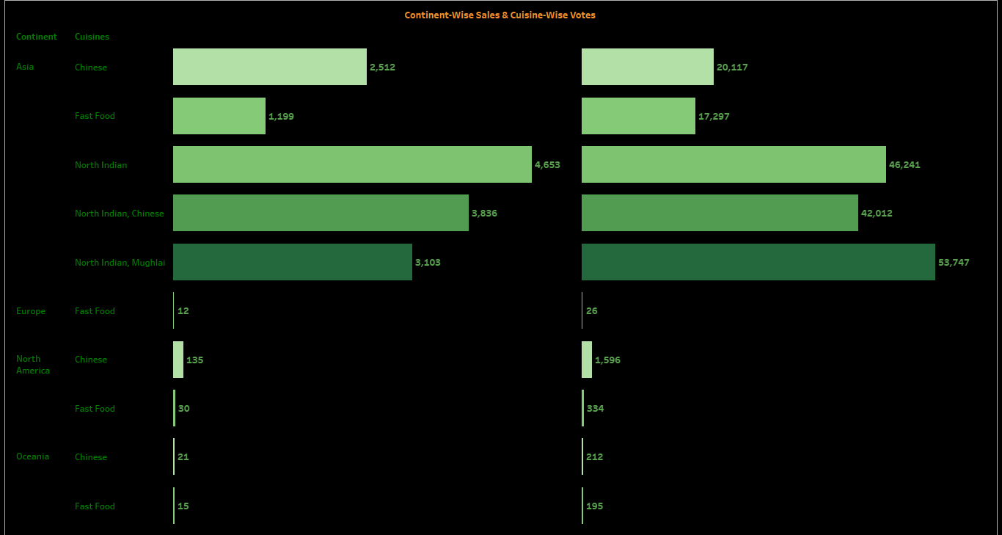
Continent & Cuisine-Wise Sales & Votes
North Indian Cuisine in Asia has highest Sales and North Indian Mughlai Cuisine is preferred by most customers throughout.

Slide 11
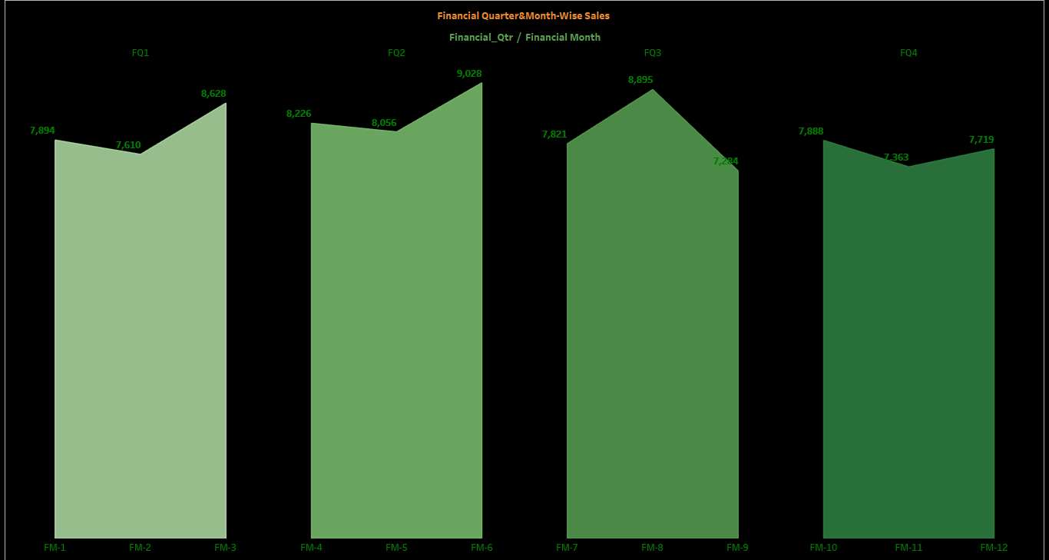
Financial Quarter & Month-Wise Sales
Throughout 9 years, FQ3 has the highest revenue generated.

Slide 12
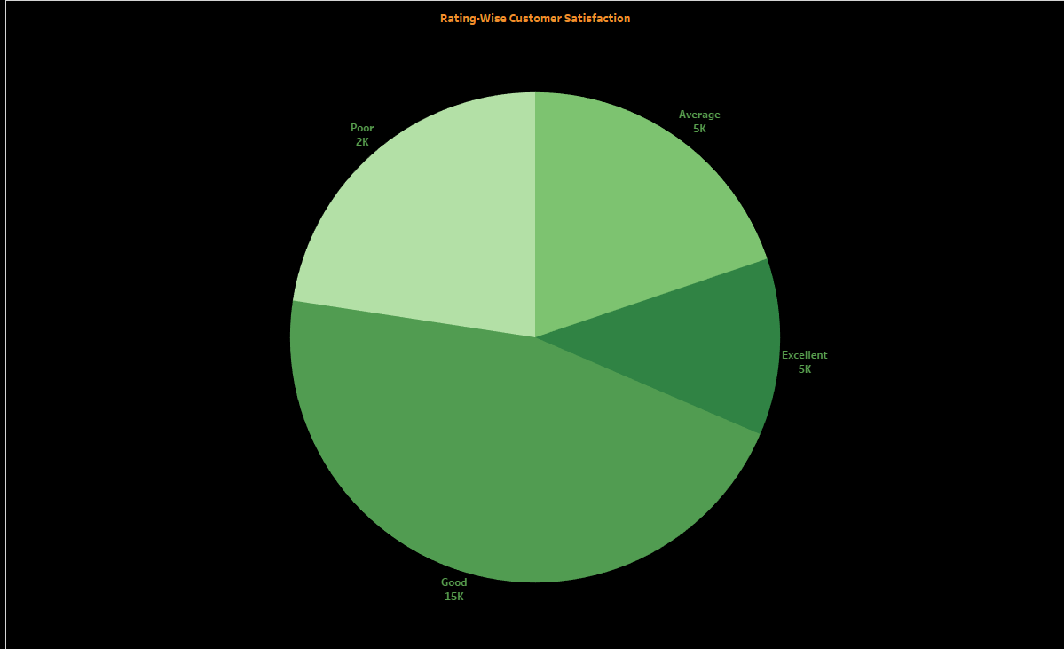
Rating-Wise Customer Satisfaction
15k customers have rated “Good” as satisfaction level.

Slide 13
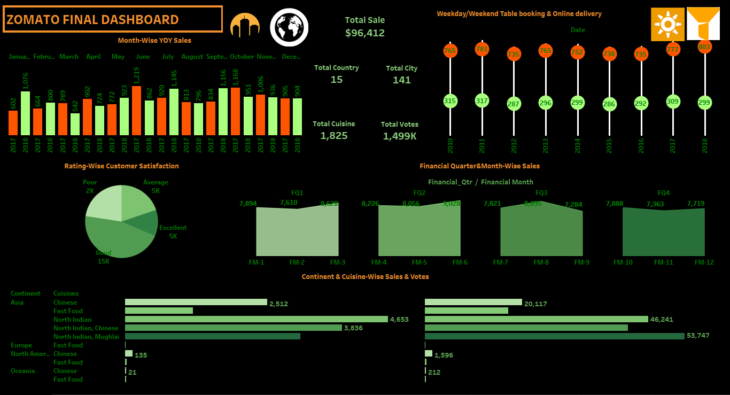

Slide 14
Insights
By visualizing the Zomato's dataset we have observed different insights:
Total sales for the last 2 years (2017-2018) :
Total sales in 2018 has been slightly higher than its previous year - 2%
Day wise preference :
Weekdays are preferred over Weekend
Financial Quarter & Month-Wise Sales throughout :
Highest sales in - FQ3
Total sales in FQ3 – $24,000
Highest Sales in Financial Month – FM 8 - $8,895

Slide 15
Insights
Rating wise Customer Satisfaction :
Least - Poor- 2k
Most – Good – 15k
PRICE BUCKET WISE RESTAURANT COUNT :
Most cuisines falls under - $0-10
Average Rating : 2.7
Total Countries : 15

Slide 16
Recommendations
Actionable strategies :
Online delivery service should be prioritized
More number of restaurants should be added in different regions.
Should focus more on Tier-2 and Tier-3 cities.
More focus on customer satisfaction is needed.
Order menu switch of customers should be encouraged by the restaurants.
Online Table booking mode should be available.

Slide 17
CONCLUSION
We have observed significant trends in user engagement, restaurant ratings, and market penetration. Zomato's expansion into new markets and innovative features such as Zomato Gold have contributed to its growth and market leadership. However, challenges such as intense competition and regulatory issues remain. Moving forward, leveraging data-driven strategies, continuous innovation, and maintaining customer satisfaction will be crucial for sustaining and enhancing Zomato's position in the dynamic food delivery industry."

Slide 18


